Slide 1
Complex Engineering Problems and Activities
Complex Engineering Problems
‹#›

Slide 2

Outcome of this session
1
Identify Complex Engineering problem attributes
Identify and map relationships between POs and Complex Engineering problem attributes
Select courses suitable to demonstrate the culmination of Program Outcomes in solving Complex Engineering Problems
2
3
Complex Engineering Problems
‹#›

Slide 3
Engineering Domain
Engineers
Research & Design
Supervision &
Maintenance
Work
Engineering Technologists
Education
Strong in Mathematics, Engineering Sciences, Professional
Appropriate Mathematics, Engineering Sciences, Professional
Engineering Breadth & Depth of Curricula |  | Engineering Technology Breadth & Depth of Curricula
courses (Theoretical)
courses (Practical)
Complex Engineering Problems
‹#›

Slide 4

Requirements
Introduced in version 2
Knowledge Profile (K1 – K8) Complex Problem Solving (P1 –P7)
Complex Engineering Activities (A1 – A5)
“The way in which each attribute of the Knowledge Profile (K1 – K8) is addressed in the curriculum must be demonstrated through mapping.”
“The program must also demonstrate how each attribute of the Range of Complex Engineering Problems (P1 – P7) and Complex Engineering Activities (A1 – A5) is incorporated in the teaching, learning and assessment.”
Complex Engineering Problems
‹#›

Slide 5
BAETE Program Outcomes
Apply knowledge of mathematics, natural science, engineering fundamentals and an engineering specialization as specified in K1 to K4 respectively to the solution of complex engineering problems.
Identify, formulate, research literature and analyse complex engineering problems reaching substantiated conclusions using first principles of mathematics, natural sciences and engineering sciences. (K1 to K4)
Design solutions for complex engineering problems and design systems, components or processes that meet specified needs with appropriate consideration for public health and safety, cultural, societal, and environmental considerations. (K5)
Conduct investigations of complex problems using research-based knowledge (K8) and research methods including design of experiments, analysis and interpretation of data, and synthesis of information to provide valid conclusions.
a
b
c
d
Complex Engineering Problems
‹#›

Slide 6
BAETE Program Outcomes
Create, select and apply appropriate techniques, resources, and modern engineering and IT tools, including prediction and modelling, to complex engineering problems, with an understanding of the limitations. (K6)
Apply reasoning informed by contextual knowledge to assess societal, health, safety, legal and cultural issues and the consequent responsibilities relevant to professional engineering practice and solutions to complex engineering problems. (K7)
Understand and evaluate the sustainability and impact of professional engineering work in the solution of complex engineering problems in societal and environmental contexts. (K7)
Apply ethical principles and commit to professional ethics and responsibilities and norms of engineering practice. (K7)
e
f
g
h
Complex Engineering Problems
‹#›

Slide 7
BAETE Program Outcomes
i
Function effectively as an individual, and as a member or leader in diverse teams and in multi-disciplinary settings.
Communicate effectively on complex engineering activities with the engineering community and with society at large, such as being able to comprehend and write effective reports and design documentation, make effective presentations, and give and receive clear instructions.
Demonstrate knowledge and understanding of engineering management principles and economic decision-making and apply these to one’s own work, as a member and leader in a team, to manage projects and in multidisciplinary environments.
Recognize the need for, and have the preparation and ability to engage in independent and life-long learning in the broadest context of technological change.
j
k
l
‹#›

Slide 8

Complex Problem
Need to think broadly and systematically and see the big picture
Complex Problem
Difficult Decision
Uncertain Strategy
Confusing Idea
Contentious Product
Intractable Change

Slide 9
Characteristic of a Complex Engineering Problem
Difficult to solver Unfamiliar to solver
Has several variables, parameters, constraints.
Has several components inter-connected and dependent to each other. The solver does not have any immediate solution.
Multiple stake-holders with different views or interests.
No clear problem boundary. The solver needs to define the problem prior solving it.
The solver needs to justify the solution.
‹#›

Slide 10
Difficulty & Uncertainty
Complexity – the problem contains a large number of diverse, dynamic and interdependent elements
Measurement – it is difficult or practically infeasible to get good qualitative data
Novelty – there is a new solution evolving or an innovative design is needed
‹#›

Slide 11




























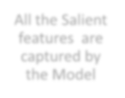







Limited Explanation, Prediction, Control
Explanation, Prediction, Control
Unbounded Systems, No Experiment
Isolatable Systems, Controlled Experiment
Results in an educated guest
Results in a
Covering Law
Complex
Complex causal Chains
Simple causal Chains
?
f(x,y,z)
Technical
A limited number of features are captured by the Model
Operating with adequate resources
All the Salient features are captured by the Model
Difficult to measure
Measurable
Operating with scare resources
‹#›

Slide 12
Characteristics
Technical Problems Complex Problems
Isolatable boundable problem
Universally similar type
Stable and/or predictable problem parameters
Limited set of alternative
solutions
Involve few or homogeneous stakeholders
Single optimal and testable solutions
Single optimal solution can be clearly recognised
No definitive problem boundary
Relatively unique or unprecedented
Unstable and/or unpredictable problem parameters
No bounded set of alternative solutions
Multiple stakeholders with different views or interest
No single optimal and/or objectively testable solution
No clear stopping point
‹#›

Slide 13




Scientific/Technical Problems
can combine to form
A
Complex Problem
‹#›

Slide 14
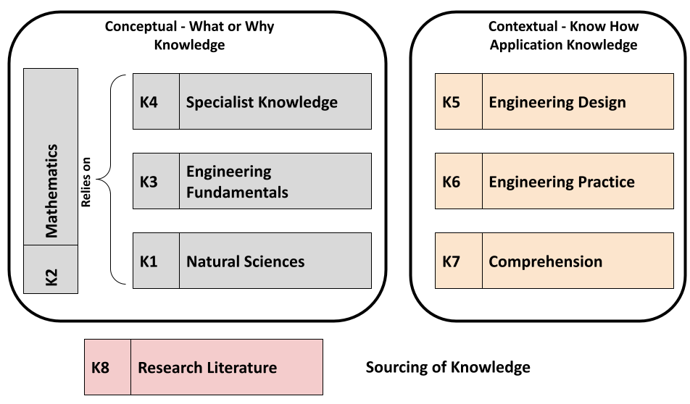
Knowledge Profile
‹#›

Slide 15
Knowledge Profile
K1 | A systematic, theory-based understanding of the natural sciences applicable to the discipline
K2 | Conceptually based mathematics, numerical analysis, statistics and the formal aspects of computer and information science to support analysis and modeling applicable to the discipline
K3 | A systematic, theory-based formulation of engineering fundamentals required in the engineering discipline
K4 | Engineering specialist knowledge that provides theoretical frameworks and bodies of knowledge for the accepted practice areas in the engineering discipline; much is at the forefront of the discipline
K5 | Knowledge that supports engineering design in a practice area
K6 | Knowledge of engineering practice (technology) in the practice areas in the engi- neering discipline
K7 | Comprehension of the role of engineering in society and identified issues in engi- neering practice in the discipline: ethics and the engineer’s professional respon- sibility to public safety; the impacts of engineering activity; economic, social, cultural, environmental and sustainability
K8 | Engagement with selected knowledge in the research literature of the discipline
‹#›

Slide 16
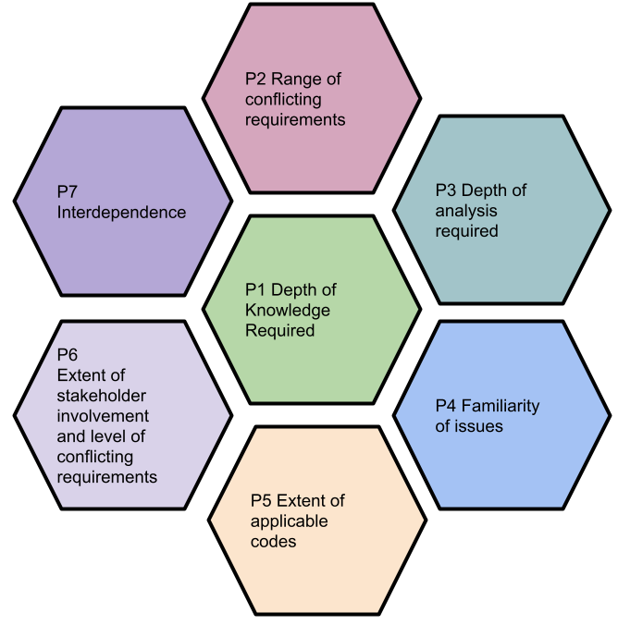
Complex Problem Solving
‹#›

Slide 17
Complex Engineering Problem Solving
Attribute | Complex Engineering Problems have characteristic P1 and some or all of P2 to P7:
Depth of knowledge required | P1: Cannot be resolved without in-depth engineering knowledge at the level of one or more of K3, K4, K5, K6 or K8 which allows a fundamentals-based, first principles analytical approach
Range of conflicting requirements | P2: Involve wide-ranging or conflicting technical, engineering and other issues
Depth of analysis required | P3: Have no obvious solution and require abstract thinking, orig- inality in analysis to formulate suitable models
Familiarity of issues | P4: Involve infrequently encountered issues
Extent of applicable codes | P5: Are outside problems encompassed by standards and codes of practice for professional engineering
Extent of stakeholder involvement and conflict ing requirements | P6: Involve diverse groups of stakeholders with widely varying needs
Interdependence | P7: Are high-level problems including many component parts or sub-problems
‹#›

Slide 18
Complex Engineering Problem Solving
P1: In–Depth Knowledge Required
knowledge gained from courses/ learning activities beyond the introductory instructional level
first Principles are the fundamental concepts/ assumptions on which a theory, system, or method is based.
Apply some standard formulae or theoretical models mixed by exposure
to similar problems
P2: Range of conflicting requirements
What constraints are placed to resolve the problem? What conflicting demands in the developing a design? How the constraints were identified?
they may have been part of the brief,
they may have only become apparent once they started addressing the problem, or
the brief may have implied or only referenced to them loosely
‹#›

Slide 19
Complex Engineering Problem Solving
P3: Depth of analysis required
What are guidance/ constraints given to develop the solution/ design? There might be multiple solutions
Students may have been given clear boundaries and specific details of what they had to do, or they may have had to define some or all of the boundaries to the problem themselves and work with limited information to decide how the work should be carried out
The problem may have been the one that they regularly encountered
but with slight case-specific variations.
P4: Familiarity of issues
New problem not previously or only rarely encountered. Familiar problem with some (or many) unique issues that made resolution difficulty level increased.
‹#›

Slide 20
Complex Engineering Problem Solving
P5: Extent of Applicable Codes
Applying engineering skill to address some parts of the problem that were not clearly prescribed by standards, codes or practices.
Having to develop own criteria (in a manner consistent with good engineering practice) because the problem was so ill-defined that it did not fall within any specific standards, codes or codified engineering practices.
P6: Extent of stakeholder involvement and level of conflicting requirements
Who are your stakeholders?
What are their interests or requirements ?
The extent these interests or requirements conflicted and/or placed constraints on the problem
How do you manage your stakeholders to resolve conflicts, meet their
requirements or reach satisfactory compromises ?
P7: Interdependence
The problem is able to be broken down into smaller components or sub-problems
‹#›

Slide 21
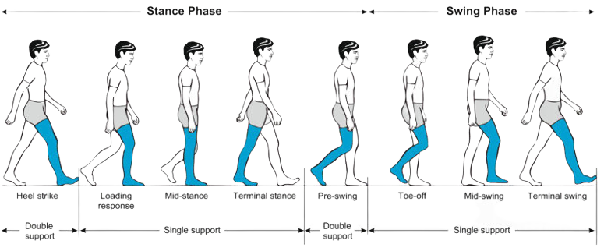
An Example
Gait Recognition
Identifying people without face recognition is very important. Gait is an unique trait that helps human recognition. Design and develop a real time gait recognition system that will use cheap video cameras and minimal processing power.
‹#›

Slide 22
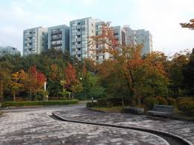
Aspects
Economics
Social
Environment
Ethics
Management
Technology
Analysis
Evaluation
‹#›

Slide 23
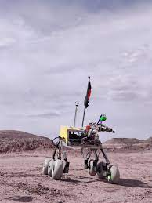
Thinking
Subject’s condition
Light exposure
Available technology
Development tools
Design
Costing
Scheduling
‹#›

Slide 24
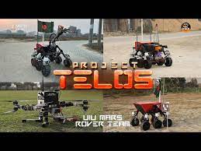
Solutions?
Problem solving skills
Formulate the problem
Literature
Experiment?
‹#›

Slide 25
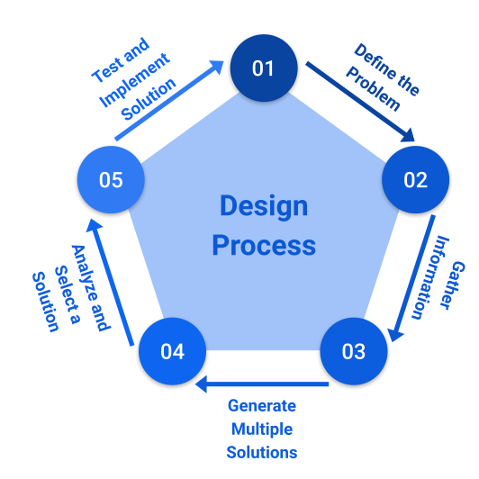
Step 1: Define the problem
Range of conflicting requirements (P2)
High accuracy Cheap video camera
Low processing power
A person might walk from any angle
Lower light environment
Few shot learning
‹#›

Slide 26
Step 2: Gather Information
Range of conflicting requirements (P2)
/ Familiarity of issues (P4) / Extent of stakeholder involvement and level of conflicting requirements (P6)
What are the existing solutions to the problem?
What is wrong with the way the problem is currently being solved? What are the available video camera or processors available?
What is the cost of the existing
solutions?
What other factors are important?
‹#›

Slide 27
Step 3: Generate Multiple Solutions
Depth of Analysis (P3) Generate images and image based features using image
processing techniques Generate milestones using pose estimation
Might need to normalize them
based on the environment, angle orientation
Data augmentation
Train few shot models Prepare inference models

Slide 28
Step 4: Analyse and selection a solution
Depth of Knowledge (P1) / Depth of Analysis (P3) / Extent of Applicable Codes (P5)
Analysis of design solutions – design problem is unique and requires different types of analysis
Functional analysis
Product safety and liability
Economic and market analysis
Analysis under different lighting conditions

Slide 29
Step 5: Test and implement a solution
Extent of applicable codes (P5)
/ Interdependence (P7)
Prototyping
Documenting the solution, planning

Slide 30
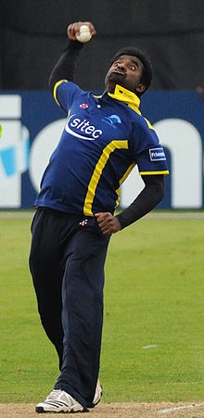
Another Example
Illegal Bowling Action Detection
In cricket, a popular game often the analysis of bowling actions are done in laboratories using bio-metric sensors. In practice, historically umpires have called bowling of certain bowlers illegal on field and resulted intro controversies. Design and develop a video based on-field illegal bowling action detection system.

Slide 31
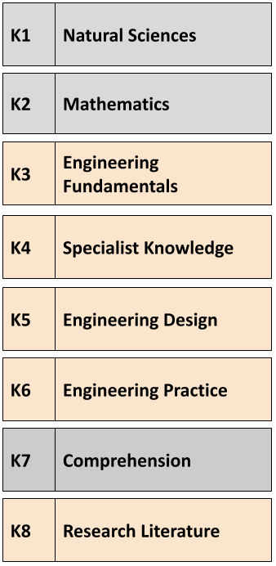
Another Example
Illegal Bowling Action Detection
In cricket, a popular game often the analysis of bowling actions are done in laboratories using bio-metric sensors. In practice, historically umpires have called bowling of certain bowlers illegal on field and resulted intro controversies. Design and develop a video based on-field illegal bowling action detection system.
P1: Depth of Knowledge Required ?

Slide 32
Another Example
Illegal Bowling Action Detection
In cricket, a popular game often the analysis of bowling actions are done in laboratories using bio-metric sensors. In practice, historically umpires have called bowling of certain bowlers illegal on field and resulted intro controversies. Design and develop a video based on-field illegal bowling action detection system.

Slide 33
Range of Complex Engineering Activities
Attribute | Complex activities means (engineering) activities or projects that have some or all of the following characteristics:
Range of resources | A1: Involve the use of diverse resources (and for this purpose resources include people, money, equipment, materials, informa- tion and technologies)
Level of interaction | A2: Require resolution of significant problems arising from inter- actions between wide-ranging or conflicting technical, engineering or other issues
Innovation | A3: Involve creative use of engineering principles and research- based knowledge in novel ways
Consequences for soci- ety and the environment | A4: Have significant consequences in a range of contexts, char- acterized by difficulty of prediction and mitigation
Familiarity | A5: Can extend beyond principles-based approaches | previous | experiences | by | applying

Slide 34
Range of Complex Engineering Activities
A1:Range of resources
What resources were available to help you carry out this engineering activity?
Negotiate adequate resources eg personnel, funding, equipment, authorisations to undertake work materials
Develop plans (including budgets) to schedule availability of resources
for allocation when required to meet project timelines and financial commitments.
Report work progress against schedule – work-flow plans, budgets,
overall project performance objectives and provide projections on work completion to target times and budget

Slide 35
Range of Complex Engineering Activities
A2:Level of interactions
What are the engineering issues or other issues that could impact on engineering matters related to the project - the expected outset of the project ?
What unforeseen engineering issues arose during the execution of the project ?
Prior to commencing the work to ensure all the engineering issues are
resolved or scheduled to be resolved to meet project plan targets, i.e., identify the potential risks with the respective proposed solution.
A3: Innovation
What new techniques, materials or processes can be utilised in the project, feasibility study (technical & economy), literature review ? How do the proposed approach improve the efficiency, effectiveness or quality of work?

Slide 36
Range of Complex Engineering Activities
A4: Consequences to society and the environment
What are the impacts of the engineering solution on the society and environment?
Who is affected and how?
A5: Familiarity
To what extent is the previous experiences routinely encountered and resolved using wellunderstood practices?
The experience is a:
New experience which is not previously or only rarely encountered. Familiar experience with some (or many) unique issues that made communication difficulty level increased.

Slide 37
AI Powered Medical Agent
There are different types of patients coming in. They will meet this automated agent powered with micro-phone and camera sensors.
The agent will be able to communicate with the patients, record their personal information and symptoms and suggest doctors or departments. Previous customers will be remembered and their medical history will be taken into consideration. Design and develop such an AI powered medical agent and present your solution in a project show in front of the investors.

Slide 38
AI Powered Medical Agent

Slide 39
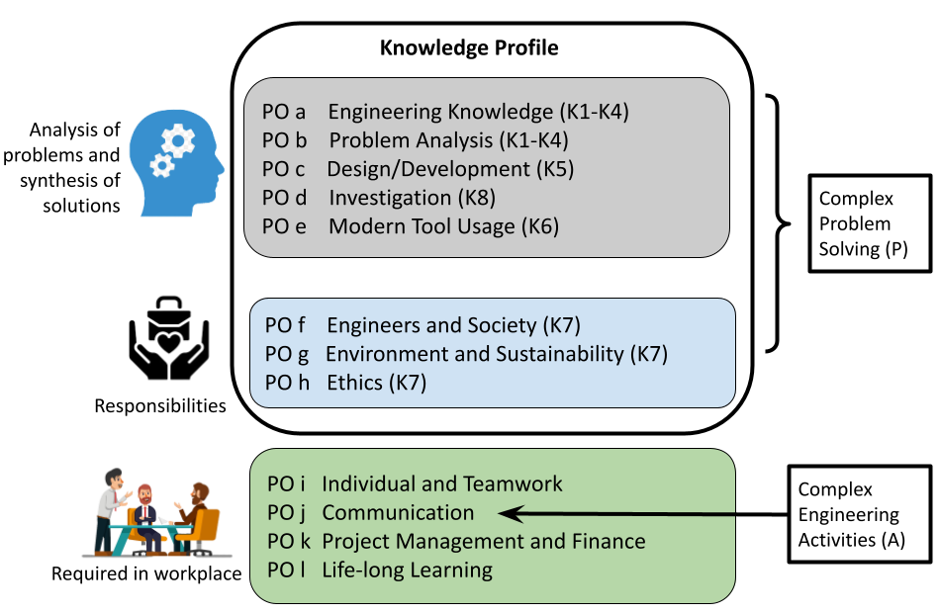
Mapping between PO-K-P-A

Slide 40
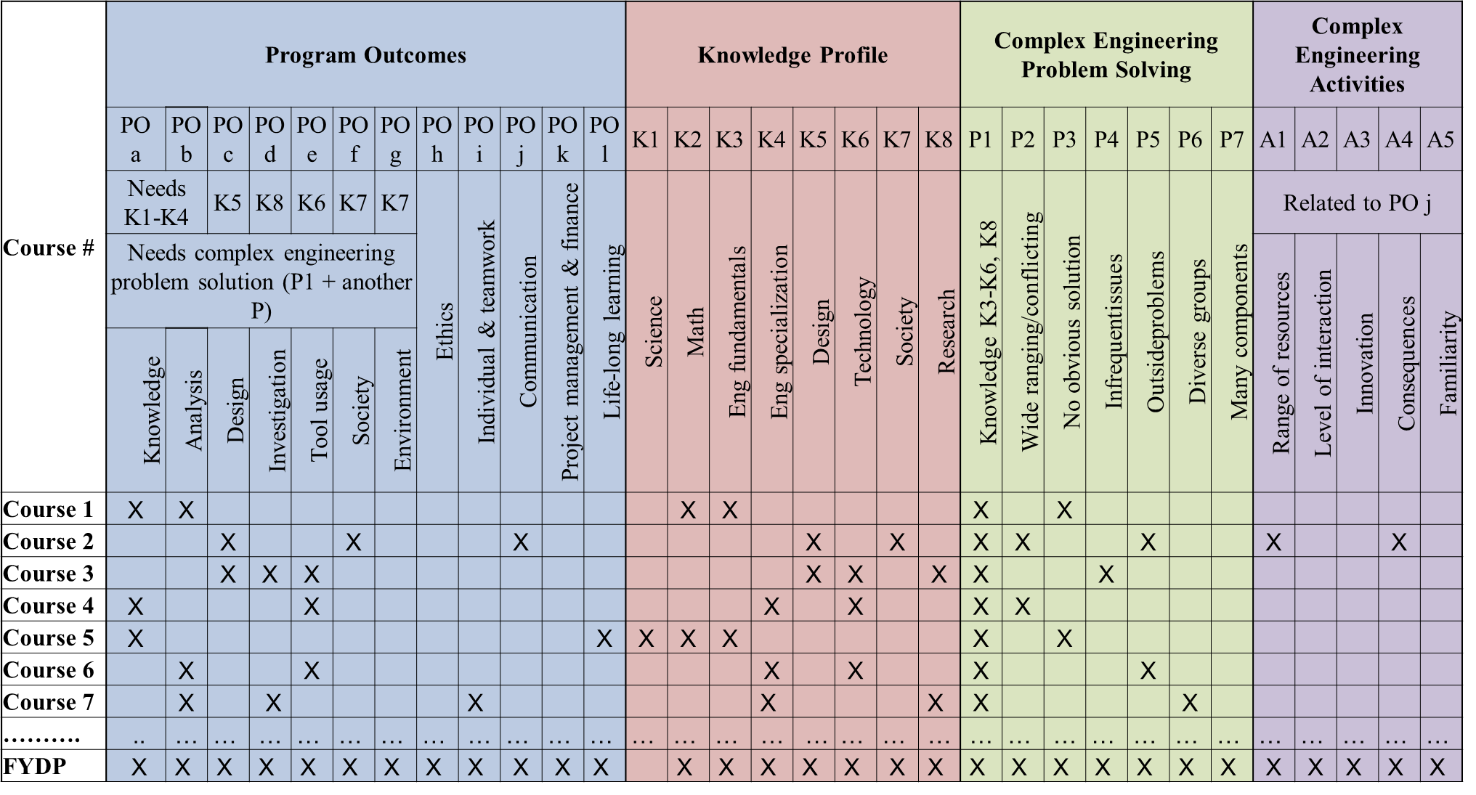
Mapping Example

Slide 41
Culmination - Design Projects
Industry-based Integrated Design Project
Employed Problem-Based Learning teaching method
Provides students opportunity to apply their skills and knowledge toward developing a robust understanding of what it means to be an engineer
Supports students to make transition from classroom-based activities
to professional communities of practices
Working with a supervisor from the industry in a type of collaboration, students are challenged with a real-world problem.
Final Year Project
Commonly known as research project
Best means of introducing an investigative research-oriented approach to engineering studies and sourcing of knowledge externally from the real-world
Involves review of open research literature which challenges students to
interpret new information, perform critical analysis, form personal opinions and judgements, and learn independently

Slide 42
Final year design project
FYDP-I
Introduction: Problem Statement Literature Review
Requirement Analysis and Defining Outcomes Project Planning: Timelines, Budget, etc.
FYDP-II
Proposed Design
Testing, Implementation and Analysis Impact Analysis
Environmental Impact and Sustainability Professional, ethical, and social impacts
Evaluation
Report, Presentation, Viva, Peer evaluation, Reflective Journals

Slide 43
Culmination - Internship/Open Ended Labs
Industry Training or Work-based Learning
Provides opportunities for students to engage in experiential education, integrating theory with work experience
Provides students with knowledge base and skills to help them translate isolated and abstract concepts into practical applications of that knowledge.
Laboratory experiences
Important elements in engineering education, bridging the gaps between engineering theories and real practices through cultivation of hands-on skills
Open-ended approach - the problem may have multiple solutions and there is no obvious solution. Focuses on student’s ability to design experiments, identify the variables or results or information to be collected and identify the appropriate instruments for the assigned problem. Produce engineering graduates that are selfdirected, reflective, demonstrate ability to integrate knowledge, think critically, practice life-long learning and work collaborative with others.

Slide 44
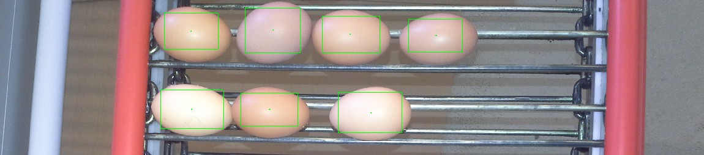
Culmination - Theory Final Exam
Computer Interfacing
Suppose, we wish to design a conveyer belt for a poultry farm. The chicken eggs will be carried by the conveyer belt. The system will have a camera sensor and a digital display board to show the count of the eggs. The motor controller for the belt and the display will be controller by a micro-controller based system.
Now, design an automated system using above stated brief. Your design must contain
followings. (Use the micro-controller/microprocessor datasheets provided with the question)
1
Equipment Configuration - specify alternates for your selection and justify.
² Algorithm / flowchart/Model for counting eggs.
³ Control State Design
⁴ Data-Processor Specification

Slide 45





Resources
Books (Library)
Journals
  IEEE Transactions
  Elsevier
  Springer
  EURASIP
  MDPI
  Others
    ISI Indexed Journals with IF(Preferably)
    Scopus Indexed Journals
    URL: sci-hub

Slide 46
Need descriptors for P/A characteristics and associated rubrics.
Assessment

Slide 47
End of Session
Acknowledgment:
Prof Swakkhar Shatabda (BracU)
Prof Meghat (Board Member, BEM)
Prof AKM Muzahidul Islam (UIU)

